Slide 1
Which defense industries go with more DoD contract dollars?
MSBA 501 · GROUP PROJECT · OCTOBER 22, 2026
A regression on 2,125 U.S. counties: aerospace, R&D and shipbuilding establishments vs. average annual DoD contract spending, 2022–2024
Andrew Massa, Mario Duarte, Matt Merino, Perry Fan
Notes:
Speaker: [Name]. 0:00–0:20. Introduce the team and the one-line question.

Slide 2
Which defense industry should a state target?
DECISION AND QUESTION
DECISION-MAKER
DECISION
A State Economic Development Director
Which defense industry (aerospace, scientific R&D or shipbuilding) to prioritize when recruiting and supporting firms in counties with DoD contracts
REGRESSION QUESTION
Among U.S. counties that received DoD contract dollars, how is the number of aerospace, R&D and shipbuilding establishments associated with average annual DoD contract spending (2022–2024), holding population, metro status and region constant?
Response: log of average annual DoD contract dollars, 2022–2024
MSBA 501 · DoD contracts and defense industries
Notes:
Speaker: [Name]. 0:20–1:30. Why it matters: states spend real effort recruiting firms, and DoD contracts are a large federal dollar flow. We want to know which kind of industrial base goes with more DoD dollars, so recruiting targets the strongest association. We say "associated with", not "causes".

Slide 3
From 3,193 counties to 2,125
DATA AND FILTERS
Step | Removed | Left
All U.S. counties | — | 3,193
No DoD contract record | −509 | 2,684
DoD $0 (464) or negative (95) | −559 | 2,125
Missing any model variable | 0 | 2,125
REPRESENTS
Every county with positive DoD contract dollars, from a few dollars to $22B a year
DOES NOT REPRESENT
Counties with no DoD contracts or net cancellations
Sources: DoD contract obligations, USAspending; establishment counts (2024, private), BLS QCEW for NAICS 3364, 5417, 3366; metro status, USDA 2023 Rural-Urban Continuum Codes; population and region, [source]
MSBA 501 · DoD contracts and defense industries
Notes:
Speaker: [Name]. 1:30–3:00. Walk the filter table with the row counts. Why drop $0 and negatives: the log of zero or a negative number doesn't exist, so they can't enter a log model. Negative totals mean cancellations (de-obligations) outweighed new awards. Each row is a county, not a year, so n = 2,125.

Slide 4
Raw variables are skewed; logs much less so
DESCRIPTIVE STATISTICS · N = 2,125
Variable | Mean | SD | Min | Median | Max | Skew
DoD $/yr, 2022–24 ($M) | 185.6 | 1,016.7 | <0.01 | 1.31 | 22,069.5 | 11.86
log DoD $ (response) | 14.17 | 3.70 | 0.77 | 14.09 | 23.82 | 0.02
Aerospace establishments | 1.75 | 9.81 | 0 | 0 | 330 | 21.12
log(1 + aerospace) | 0.43 | 0.76 | 0 | 0 | 5.80 | 2.27
R&D establishments | 18.94 | 80.41 | 0 | 2 | 1,881 | 11.52
log(1 + R&D) | 1.39 | 1.46 | 0 | 1.10 | 7.54 | 1.19
Shipbuilding establishments | 0.94 | 4.42 | 0 | 0 | 124 | 14.77
log(1 + shipbuilding) | 0.28 | 0.62 | 0 | 0 | 4.83 | 2.77
Population, 2020 (000s) | 147.6 | 399.6 | 0.6 | 43.1 | 9,996.6 | 11.24
log population | 10.82 | 1.37 | 6.39 | 10.67 | 16.12 | 0.35
Metro 1,018 · Nonmetro 1,107 | South 965 · Midwest 642 · West 323 · Northeast 195 | Counties with zero establishments: aerospace 67%, R&D 31%, shipbuilding 77%
MSBA 501 · DoD contracts and defense industries · shaded rows enter the model
Notes:
Speaker: [Name]. Shape of the response: raw DoD dollars have skew 11.9, mean $186M vs median $1.3M, so a few counties dominate. Logged, skew is 0.02, essentially symmetric. Many counties have zero establishments, which is why we use log(1 + count). Shaded rows are the versions that go into the model.

Slide 5
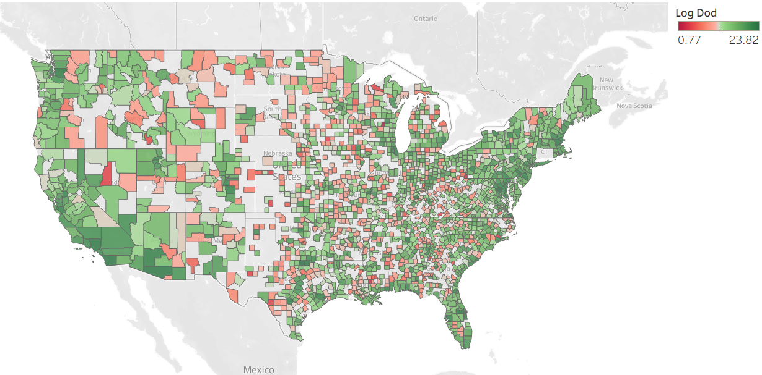
So, where does the money flow?
Visual Analysis

Slide 6
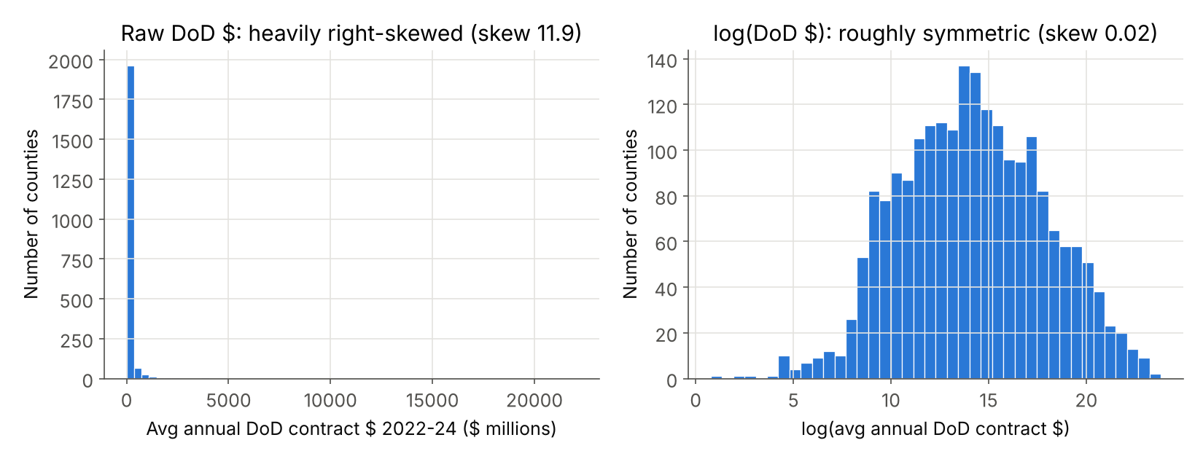
Raw dollars are extremely skewed, so we model log(DoD $)
EDA 1 OF 3 · SHAPE OF THE RESPONSE
MSBA 501 · DoD contracts and defense industries · n = 2,125 counties
Notes:
Speaker: [Name]. 3:00–3:30. Modelling choice: the raw response has skew 11.9, so a handful of counties would dominate a linear model. The log is bell-shaped (skew 0.02), which is why the response is log(DoD $). This is the log(y) transform from the extra-credit list.

Slide 7
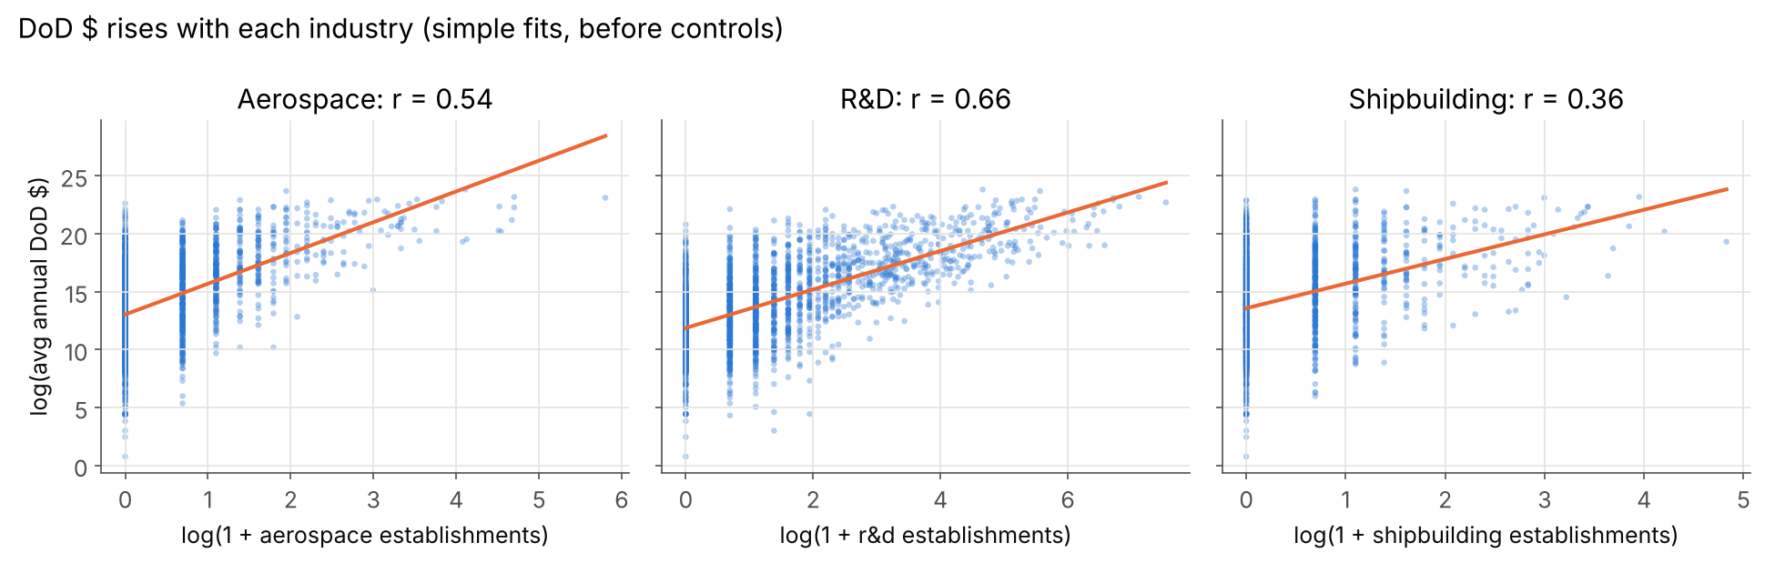
Each industry rises roughly linearly with log(DoD $)
EDA 2 OF 3 · THE THREE INDUSTRIES
Linear in logs, so we use log(1 + count). Shipbuilding is the weakest simple relationship (r = 0.36).
MSBA 501 · DoD contracts and defense industries · simple fits, before controls
Notes:
Speaker: [Name]. 3:30–4:00. Modelling choice: the relationships look linear on the log scale, so the predictors enter as log(1 + count). The +1 keeps counties with zero establishments in the data. These are simple correlations before controls; the regression holds the others constant.

Slide 8
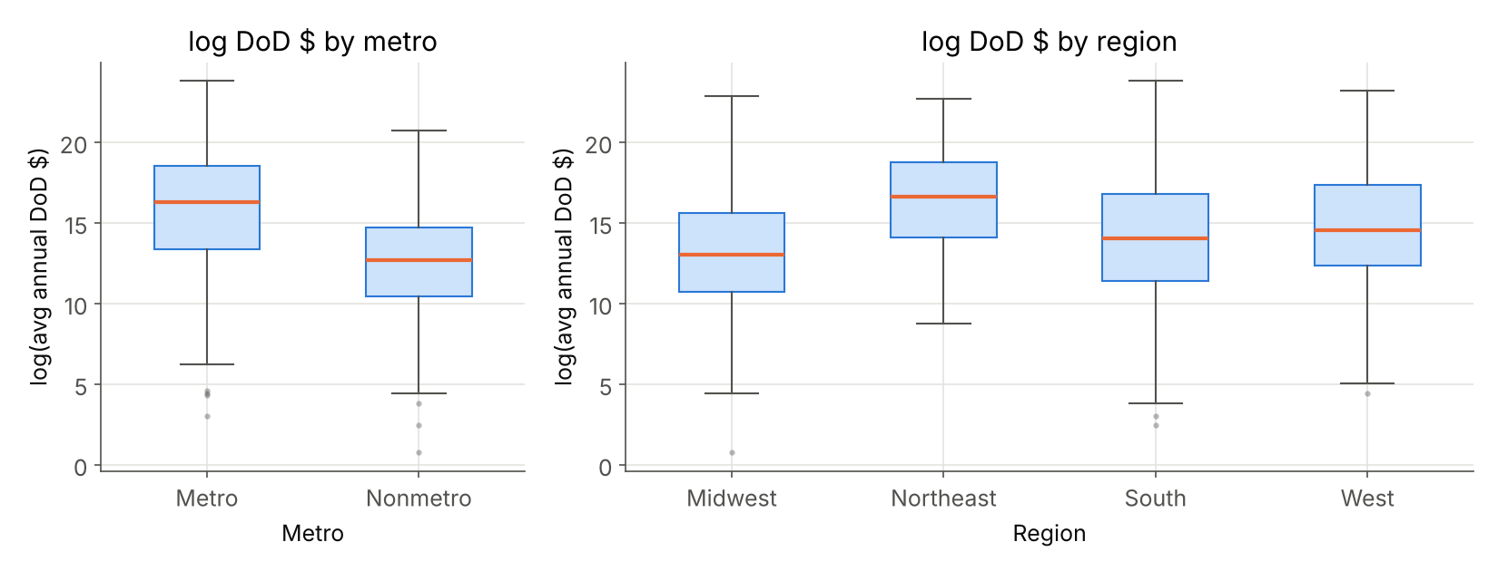
Metro status and region shift DoD $, so both enter as dummies
EDA 3 OF 3 · CATEGORICAL PREDICTORS
MSBA 501 · DoD contracts and defense industries · baselines: Metro, Midwest
Notes:
Speaker: [Name]. 4:00–4:30. Modelling choice: metro counties sit well above nonmetro, and regions differ, so metro and region go in as dummy variables. Metro means part of an OMB metropolitan area (USDA codes 1–3). Baselines are Metro and Midwest. If short on time, move this chart to the end.

Slide 9
Aerospace and R&D have the largest effects
MULTIPLE REGRESSION · OLS · N = 2,125
log(DoD $) = b0 + b1·log(1+aero) + b2·log(1+R&D) + b3·log(1+ship) + b4·log(pop) + b5·Nonmetro + b6–b8·Region + e
Predictor | Coef. | SE | t | p | 95% CI
Intercept | 4.328 | 0.850 | 5.09 | <0.001 | 2.66 to 6.00
log(1 + aerospace) | 0.663 | 0.108 | 6.13 | <0.001 | 0.45 to 0.88
log(1 + R&D) | 0.673 | 0.074 | 9.13 | <0.001 | 0.53 to 0.82
log(1 + shipbuilding) | 0.218 | 0.106 | 2.06 | 0.039 | 0.01 to 0.43
log population | 0.781 | 0.081 | 9.60 | <0.001 | 0.62 to 0.94
Nonmetro (dummy) | −0.413 | 0.146 | −2.83 | 0.005 | −0.70 to −0.13
Northeast (dummy) | 1.124 | 0.224 | 5.02 | <0.001 | 0.69 to 1.56
South (dummy) | 0.341 | 0.136 | 2.50 | 0.012 | 0.07 to 0.61
West (dummy) | 0.428 | 0.186 | 2.29 | 0.022 | 0.06 to 0.79
MSBA 501 · DoD contracts and defense industries · baselines: Metro, Midwest · blue rows: the three industries
Notes:
Speaker: [Name]. 4:30–5:30. Four quantitative predictors plus dummies for metro status and region. All three industry coefficients are significant at 0.05 (t-test, H0: b = 0). Aerospace and R&D are far larger than shipbuilding, and shipbuilding's interval sits almost entirely below theirs.

Slide 10
What each coefficient means in dollars
INTERPRETING THE COEFFICIENTS
+.66%
+.67%
Holding R&D, shipbuilding, population, metro and region constant, a 1% increase in (1 + aerospace establishments) is associated with 0.66% more DoD dollars a year, on average.
Holding aerospace, shipbuilding, population, metro and region constant, a 1% increase in (1 + R&D establishments) is associated with 0.67% more DoD dollars a year, on average.
−34%
+.22%
Holding all three industries, population and region constant, nonmetro counties are associated with 34% fewer DoD dollars a year than metro counties, on average.
Holding aerospace, R&D, population, metro and region constant, a 1% increase in (1 + shipbuilding establishments) is associated with 0.22% more DoD dollars a year, on average.
Notes:
Speaker: [Name]. 5:30–7:00. Both sides are logged, so doubling the input multiplies DoD dollars by 2 to the power b. Aerospace: 2^0.663 = 1.58, so 58% more. R&D: 2^0.673 = 1.59. Shipbuilding: 2^0.218 = 1.16. Nonmetro dummy: e^−0.413 = 0.66, so 34% less. Population (not shown): 2^0.781 = 1.72, so 72% more. All "is associated with", never "causes".

Slide 11
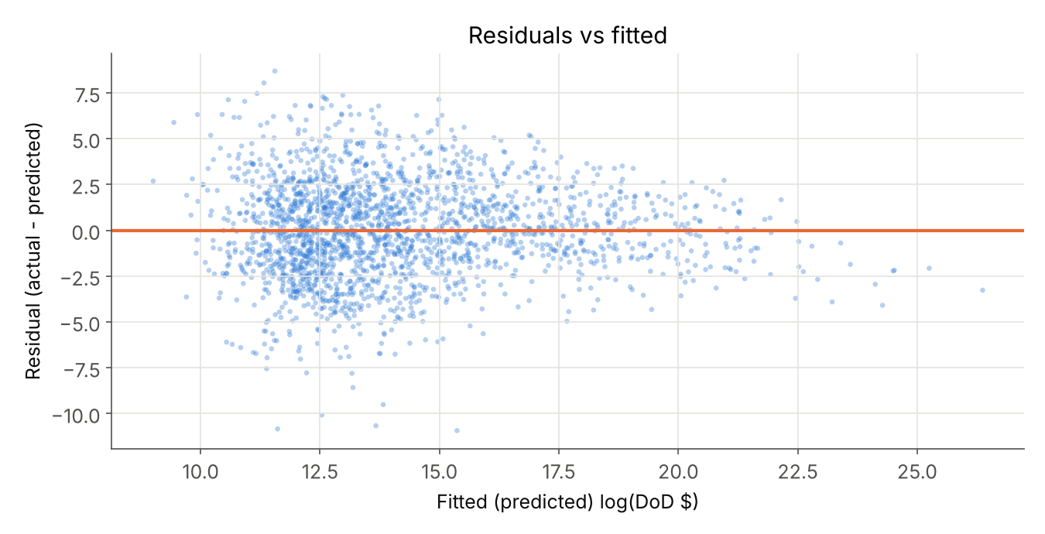
Half the variation explained; spread is uneven
MODEL FIT AND DIAGNOSTICS
R²
Adjusted R²
se (log DoD $)
Largest VIF
0.496
0.494
2.630
3.81
Multicollinearity: OK. All VIFs 1.3 to 3.8, under 5.
Residual check: fails on equal spread. Residuals center on 0 with no curve, but the band is wider for small-dollar counties and narrower for large ones.
So: coefficients are usable; p-values and intervals are less reliable.
MSBA 501 · DoD contracts and defense industries · n = 2,125
Notes:
Speaker: [Name]. 7:00–7:50. R² 0.496: the model explains about half the variation in log DoD dollars. Adjusted R² barely drops, so the predictors aren't padding. se 2.630 is in log units; e^2.63 ≈ 14, so a typical county's actual dollars can be off by a factor of about 14 either way. VIFs are all under 5, so the predictors aren't too correlated with each other. Residual check: each dot is a county, actual minus predicted. We want an even band around zero. Ours centers on zero, but the band narrows as predictions get larger, so we report that diagnostic as failed.

Slide 12
For a typical county, one aerospace firm goes with the biggest jump
PREDICTION · A TYPICAL COUNTY
Typical county: sample medians (0 aerospace, 2 R&D, 0 shipbuilding, population 43,086), Nonmetro, South
Profile | Predicted average DoD $/yr | 95% CI for the average
Typical county | $0.62M | $0.48M to $0.79M
+1 aerospace establishment | $0.97M | $0.77M to $1.24M
+1 R&D establishment | $0.75M | $0.58M to $0.96M
+1 shipbuilding establishment | $0.72M | $0.56M to $0.92M
One single typical county: 95% prediction interval $3,500 to $108M
log scale: 13.330 ± 1.961 × 2.633 = [8.167, 18.494]. The model pins down the average well; any one county varies far more. 95.0% of our counties fall inside their own interval.
MSBA 501 · DoD contracts and defense industries · CI = average of all such counties; prediction interval = one county
Notes:
Speaker: [Name]. 7:50–8:30. Same typical county four ways. Counties like this with one aerospace establishment average about $0.97M a year in DoD contracts, versus $0.62M with none: about 58% more, because going from 0 to 1 doubles (1 + count). One more R&D firm is a smaller step here because the county already has 2. These are associations across counties, not the effect of adding a firm. The confidence interval is for the average county with that profile; the prediction interval in the dark box is for one county, and it is much wider because half the variation is unexplained. It still works as designed: 95.0% of counties fall inside their own interval.

Slide 13
Prioritize aerospace or R&D; shipbuilding trails
RECOMMENDATION
t-test (H0: b = 0) | b | t | p | 95% CI | Decision (α = 0.05)
Aerospace | 0.663 | 6.13 | <0.001 | 0.45 to 0.88 | Reject H0
R&D | 0.673 | 9.13 | <0.001 | 0.53 to 0.82 | Reject H0
Shipbuilding | 0.218 | 2.06 | 0.039 | 0.01 to 0.43 | Reject H0
Competing models | n | Adj. R² | se | b aero | b R&D | b ship
A · Main model (used) | 2,125 | 0.494 | 2.63 | 0.66 | 0.67 | 0.22
B · Industries only | 2,125 | 0.454 | 2.73 | 0.86 | 1.30 | 0.38
C · Main + federal jobs | 2,125 | 0.543 | 2.50 | 0.49 | 0.45 | 0.21
D · Main, 2017–19 DoD $ | 1,971 | 0.475 | 2.34 | 0.65 | 0.50 | 0.25
Shipbuilding’s CI ends at 0.43, below where aerospace’s (0.45) and R&D’s (0.53) begin. Aerospace and R&D overlap, so we can’t rank them. The ranking holds in all four models.
MSBA 501 · DoD contracts and defense industries · extra credit: t-tests, confidence intervals, competing models
Notes:
Speaker: [Name]. 8:30–9:15. All three industries are significantly associated with DoD dollars (we reject H0: b = 0 for each). Aerospace and R&D are much larger than shipbuilding; their confidence intervals don't overlap shipbuilding's. Model B drops the controls; C adds federal jobs, which fits better but partly measures DoD presence itself (bases), so we don't use it; D uses pre-COVID dollars and gives the same ranking.

Slide 14
What this analysis cannot support
LIMITS
Cause and effect
DoD dollars may attract establishments as much as the reverse, and both are measured at the same time. Incentives are not proven to raise contracts.
Failed diagnostic: unequal spread
Residuals are wider at low fitted values, so p-values and intervals are less reliable.
Missing factors and wide intervals
Military bases and other drivers are not in the model; half the variation is unexplained, so single-county predictions are imprecise.
MSBA 501 · DoD contracts and defense industries
Notes:
Speaker: [Name]. 9:15–9:45. Be direct: association, not causation. On shipbuilding: region dummies don't control for coastline. When we fit the same model only on counties with at least one shipbuilding establishment (n = 496), shipbuilding's coefficient is 0.48 (p = 0.005), close to aerospace's 0.46. So for coastal or waterway counties, shipbuilding may matter as much. If asked about bases: federal jobs (Model C) partly capture them.

Slide 15
How we used AI, and how we checked it
AI STATEMENT
TOOL
USED FOR
Claude
Comparing candidate questions against the rubric, helping write the Python analysis code (pandas, statsmodels) and charts, drafting slide theme
HOW WE VERIFIED
Re-ran the notebook end to end ourselves · Checked each filter’s row count against the raw file · Matched 2024 establishment counts to the raw BLS QCEW files
MSBA 501 · DoD contracts and defense industries · Questions?
Notes:
Speaker: [Name]. 9:45–10:00. Bracketed items are placeholders: keep only the checks the team actually did. Then open for Q&A; say "we don't know" when that's the honest answer.

